Slide 1
Foreign Currency Arbitrage
The exchange rates for five currencies are given below. The data were collected at market close of 28th March 2014 from bloomberg.com/markets/currencies.
The rates are spot rates – money must change hands (settle the transaction) within 2 business days.
Practice Question 1: If you exchanged USD1,000,000 for pounds, and exchanged it back to dollars, how much will you have?
Cross Currency Spot Rates on 28 Mar 2014
 | To | USD | GBP | EUR | JPY | AUD
From | USD |  | 0.60100 | 0.72720 | 102.830 | 1.08140
 | GBP | 1.66380 |  | 1.20990 | 171.087 | 1.79920
 | EUR | 1.37520 | 0.82650 |  | 141.400 | 1.48710
 | JPY | 0.00970 | 0.00580 | 0.00710 |  | 0.01050
 | AUD | 0.92470 | 0.55580 | 0.67250 | 95.0910

Slide 2
Background Information
Practice Question 2: If you exchanged USD1,000,000 for AUD -> EUR -> USD, how much will you have?
Occasionally market prices become “out of line” – a sequence of currency transactions can create more money than what you started with – a “money pump”.
Task: Identify the most profitable money pump, i.e. a sequence of currency transactions that maximize returns on a unit dollar.
Cross Currency Spot Rates on 28 Mar 2014
 | To | USD | GBP | EUR | JPY | AUD
From | USD |  | 0.60100 | 0.72720 | 102.830 | 1.08140
 | GBP | 1.66380 |  | 1.20990 | 171.087 | 1.79920
 | EUR | 1.37520 | 0.82650 |  | 141.400 | 1.48710
 | JPY | 0.00970 | 0.00580 | 0.00710 |  | 0.01050
 | AUD | 0.92470 | 0.55580 | 0.67250 | 95.0910

Slide 3
Solution
Represent a sequence of transactions as a cycle of one unit of flow through the network of currencies. How many supply and demand nodes are there?
The cycle USD->AUD->EUR->USD results in a return factor of
1.0814 x 0.6725 x 1.3752 = 1.000103
To turn multiplication into something linear, take logarithms:
log(1.0814) + log(0.6725) + log(1.3752) = log(1.000103)
i.e. the unit of flow picks up a reward equal to the log(exchange rate) for each arc of the currency network.
Find the cycle that maximizes sum of the log(exchange rate).
€
log(1.3752)
log(0.6725)
$
A
log(1.0814)
¥
£

Slide 4
Algebraic formulation
: 0 or 1 flow from currency i to currency j
Maximize log(return)
All nodes in a cycle have to be transshipment nodes (net outflow = 0)
To prevent intersecting paths, total outflow <= 1

Slide 5
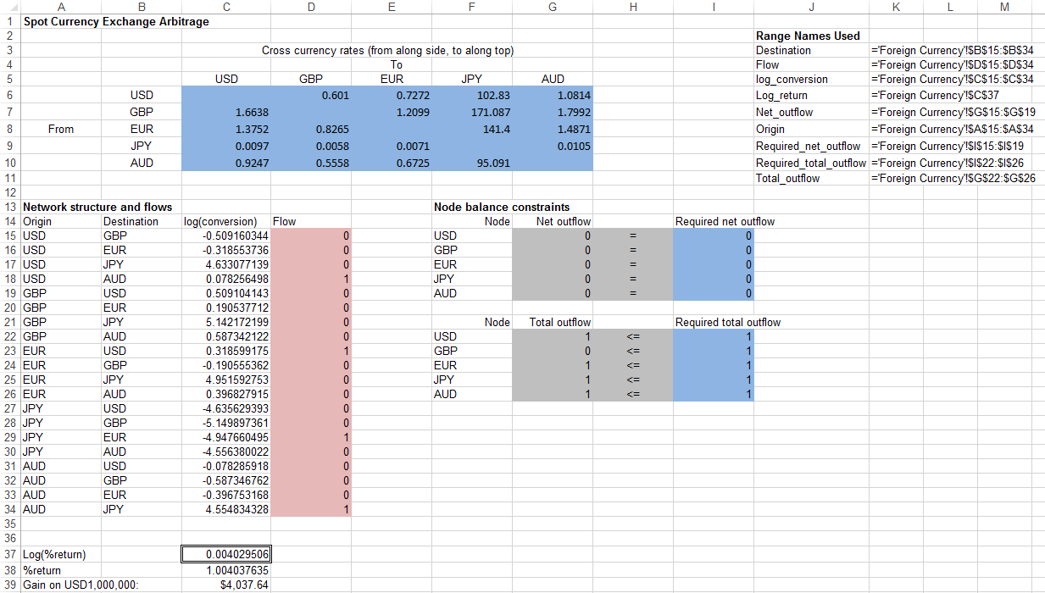
Foreign Currency Arbitrage.xls

Slide 6
Solution
The optimal sequence is USD -> AUD -> JPY -> EUR -> USD, netting $4,038 per $1M.
Likely too optimistic – market prices should be more efficient. Don’t trust free quotations!
Discussion: What else do traders do in order to achieve better returns?
€
$
A
¥
£

Slide 7
Cycles and Tours Models
The previous problem is an example of finding a cycle of unit flow through a network. A cycle does not have to pass through every node in the network.
A tour is a cycle that passes through every point in the network exactly once (no intersection). Requiring the cycle to be a tour is a much harder problem.
Traveling Salesman Problem
A UPS truck leaves the North Haven depot to deliver parcels to New Haven, Hamden and Branford. In what order should the destinations be visited to minimize distance traveled?
Distance (mi) | North Haven | New Haven | Hamden | Branford
North Haven |  | 10.7 | 3.8 | 15.2
New Haven | 10.7 |  | 6.6 | 7.8
Hamden | 3.8 | 6.6 |  | 15.2
Branford | 15.2 | 7.8 | 15.2

Slide 8
Background Information
The truck wants to find the shortest way to visit all the cities just once and return to whence it came, i.e. find the shortest tour through the network.
How can we formulate this as a network flow problem?

Slide 9
Proper network LP formulation
Every node has exactly one unit of inflow and one unit of outflow
1
0
1
1
1
3
1
2
Every subset of nodes have at least one unit of inflow and one unit of outflow (guarantees connectedness)
1
1
0
1
0
1
1
1
1
3
1
2
3
2
1
Network formulation does not scale with the number of cities
# of cities | 4 | 5 | 6 | 7 | 8 | 9 | 10 | 20 | 30
# of constraints | 14 | 30 | 62 | 126 | 254 | 510 | 1022 | 1048574 | 1073741822

Slide 10
Solution
Easier*: Check all 6 possible ways to visit the cities. Index North Haven as ‘0’, New Haven as ‘1’, Hamden as ‘2’ and Branford as ‘3’. Routes are defined by 0-1-2-3-0, 0-1-3-2-0 etc.
Make a spreadsheet that takes as input the travel order and calculates the roundtrip travel distance. See Traveling Salesman.xls.
Hint: To look up the i-th row and j-th column entry in a table, use =INDEX(Table_Range_Name, i, j).

Slide 11
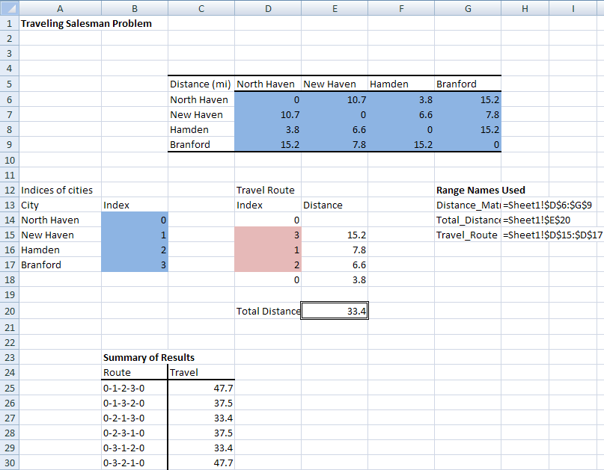
Traveling Salesman.xls

Slide 12
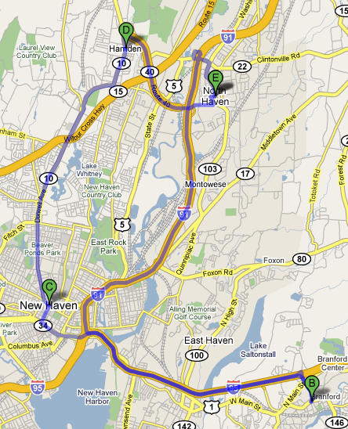
Developing the Model
Travel Route. The start and last stop is North Haven, so enter 0 into D14 and D18. Put any permutation of 123 into cells D15-D17.
Distance of each leg of trip. Perform a lookup of the distance between North Haven and the first stop by entering into E15 =INDEX(Distance_Matrix,D14+1,D15+1) and copy it down to E18. The +1’s are necessary because we have indexed the cities from 0 to 3 instead of 1 to 4.
Test your answer using Google Maps!

Slide 13
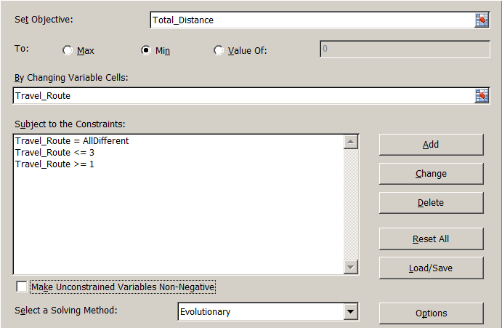
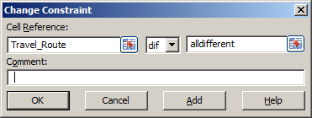
Using Evolutionary Solver (PMS Ex. 8.9)
Solver has a easier way for finding an approximate solution using the Evolutionary method. Not guaranteed to find the shortest tour when there is a huge number of nodes, but is often pretty good.
Minimize total distance subject to the constraints that all indices on the route (other than North Haven’s) are between 1 and 3, and they must all be different. In Evolutionary mode the “dif” option in the constraint menu allows you to specify the alldifferent constraint on the indices.

